Slide 1
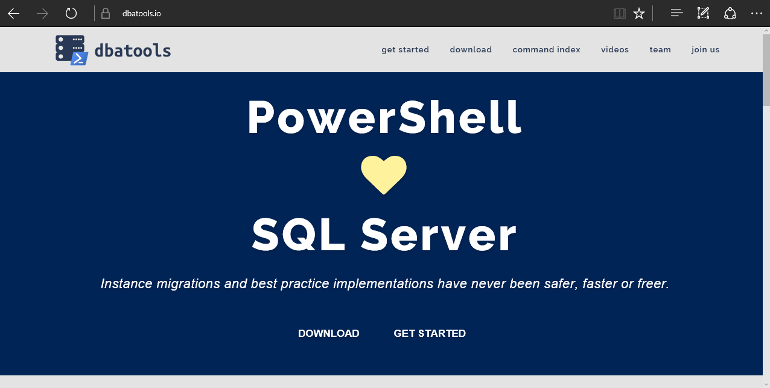
dbatools: Moderne Datenbank Administration
Marco Kleinert - PowerShell Saturday am 26.08.2017

Slide 2
Agenda
Overview
What
Demos, demos $ some more demos
Questions

Slide 3
Overview - Requirements
Minimum
Client
PowerShell v3
SQL Server Management Studio 2008 R2
Server
SQL Server 2000
No PowerShell for pure SQL commands
PowerShell v2 for Windows commands
Recommended
Client
PowerShell v5
SQL Server Management Studio 2012+
Server
SQL Server 2005+
incl. vNext
Express – Datacenter Edition
Clustered and stand-alone instances

Slide 4
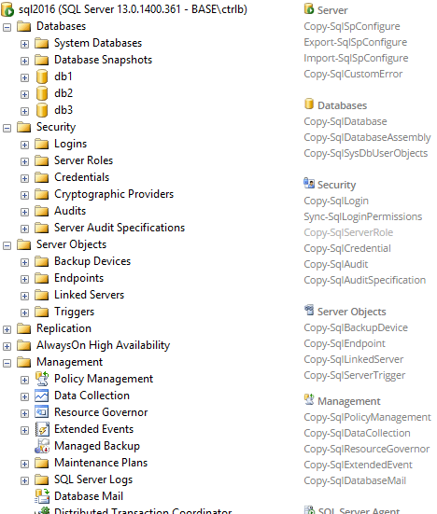

Overview - Available Commands
dbatools is a free PowerShell module with over 270 SQL Server administration, best practice and migration commands included.

Slide 5
What
Databases
Logins
Jobs & Schedules
Server Configurations
Linked Servers
Credentials
Reporting Services
Integration Services
Maintenance objects
Availability Groups
Replication Settings
Central Management Server
Operators
Alerts
Proxies
Certificates
Policy Management
Resource Pools
... not an exhaustive list
Notes:
There’s a lot to migrate. Pretty much everything you see in SQL Server Management Studio can and perhaps should be migrated.
Server Configs include things like like backup compression defaults, enabling the CLR, etc.
Maintenance objects include things like Ola Hallengren’s backup scripts in the msdb database.

Slide 6
Demo
Using dbatools to migrate from a SQL Server 2012 instance to SQL Server 2014
* all databases
Notes:
Demo time!

Slide 7
Questions?
Notes:
You can hit me up on Twitter, too. @cl

